Slide 1
Luggage Opportunity - Backpack
Adnaan Chida

Slide 2
Materials:
Nylon(Cordura)
Plastic zippers for security compartments
Heavy duty bonded thread

Slide 3
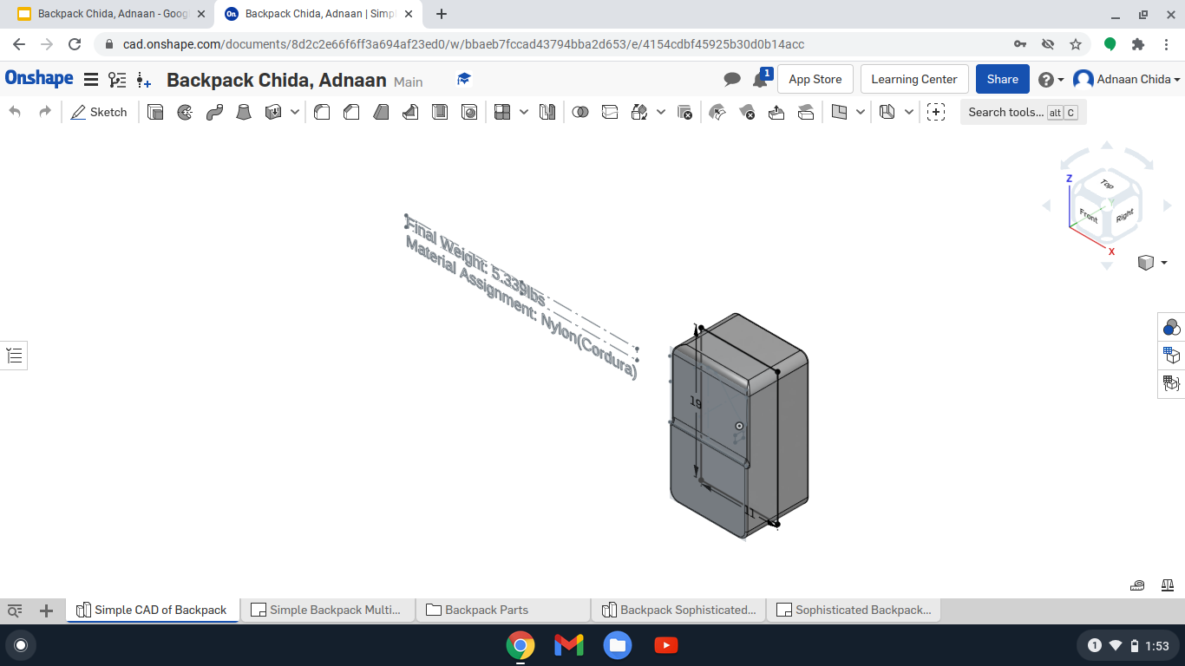
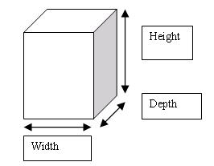
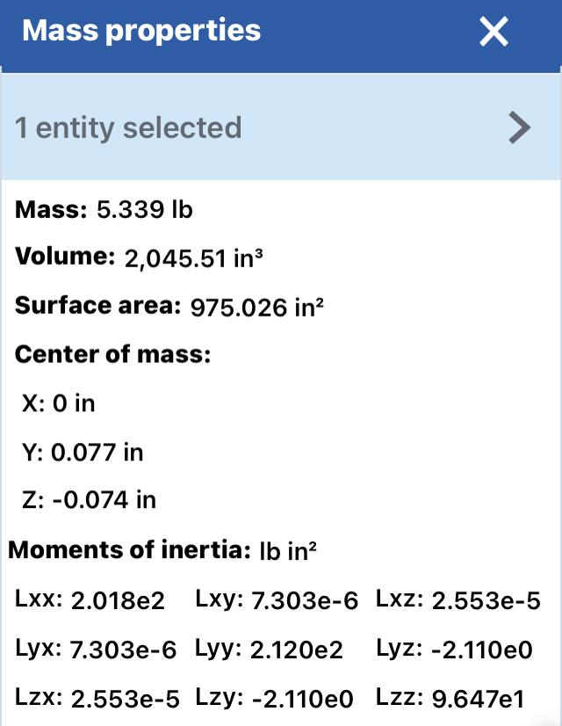
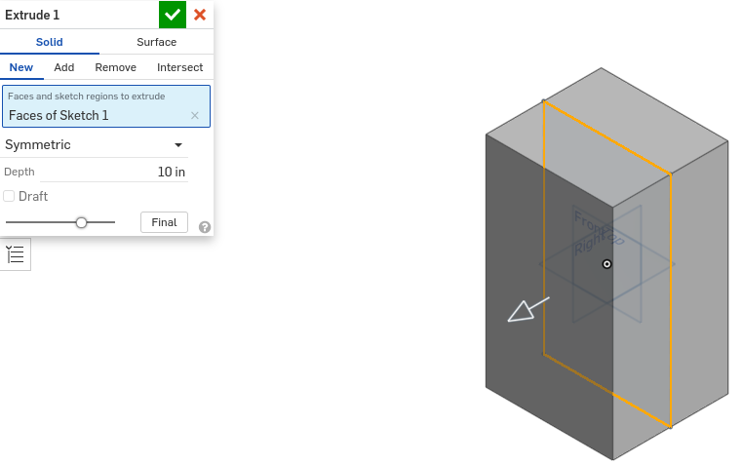
Key Measurements
Volume - 2045.51in^3
Mass - 5.339lbs
Dimension:
Length: 11in
Height: 19in
Depth: 10in

Slide 4
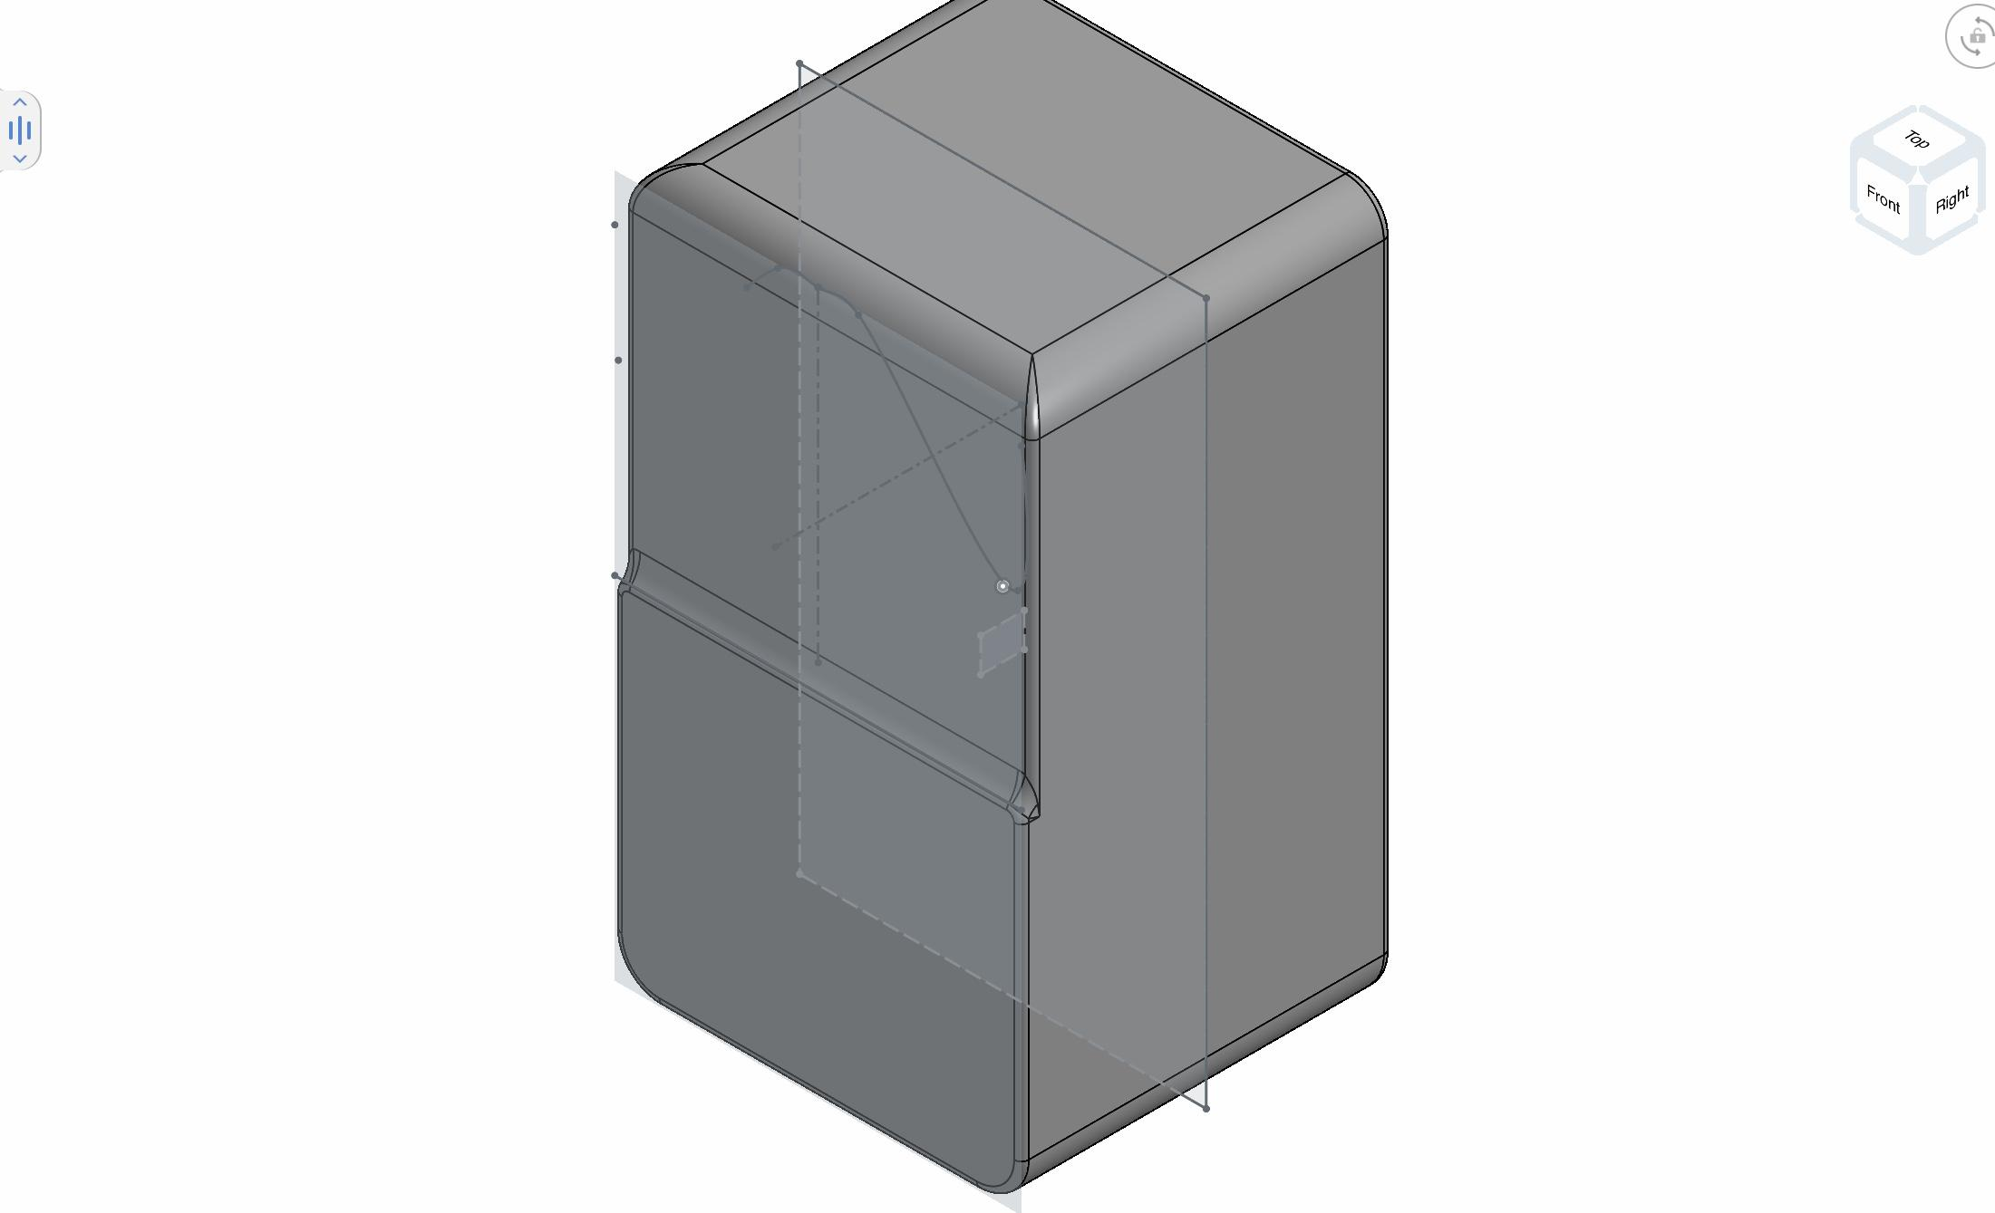
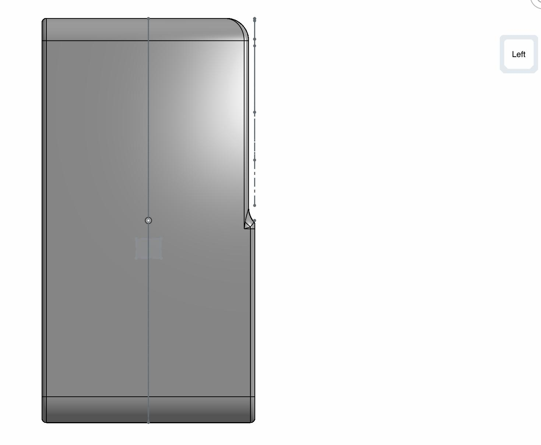
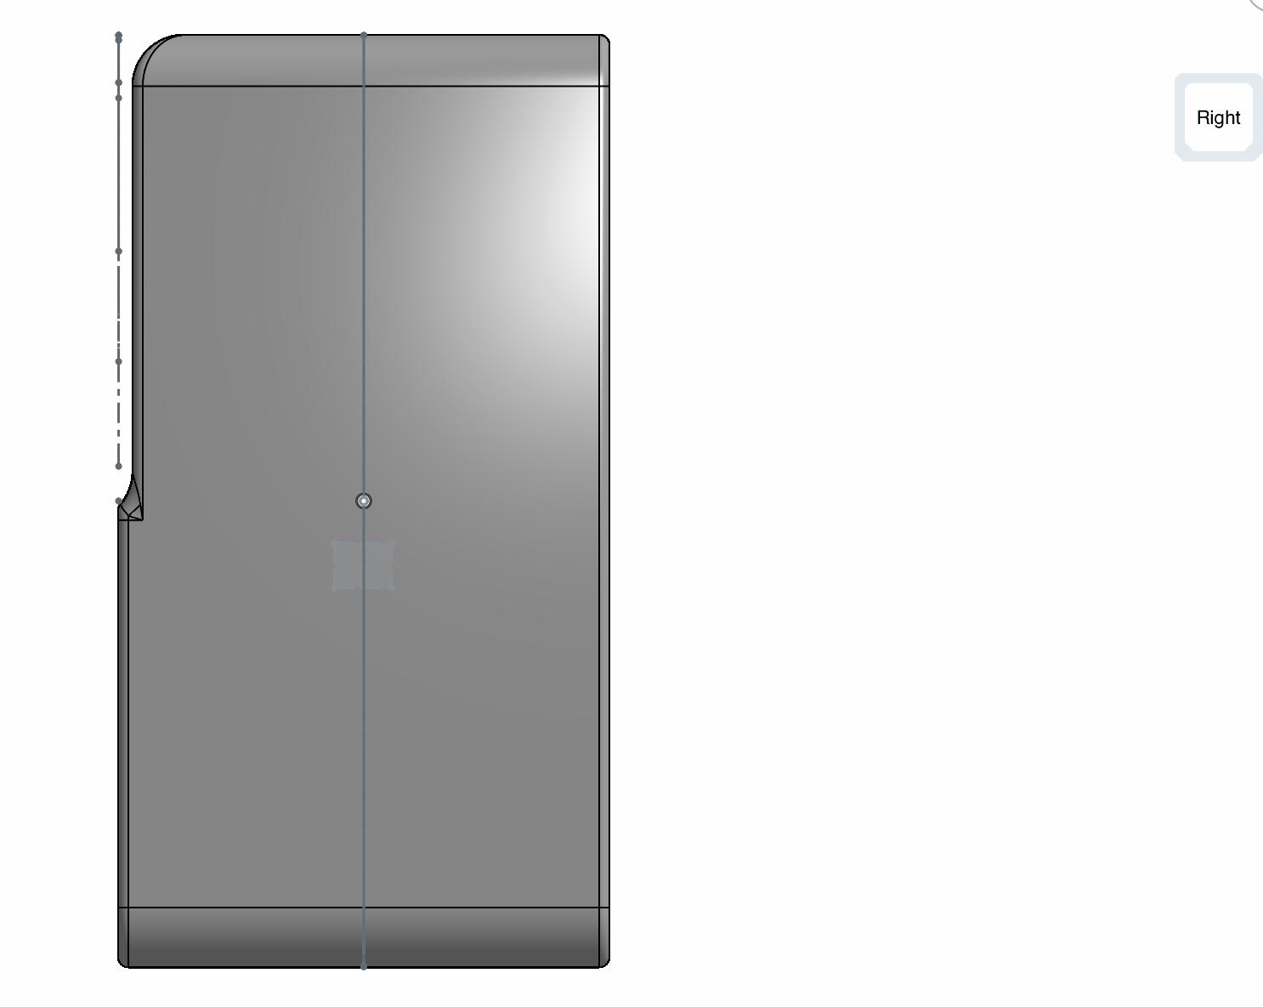
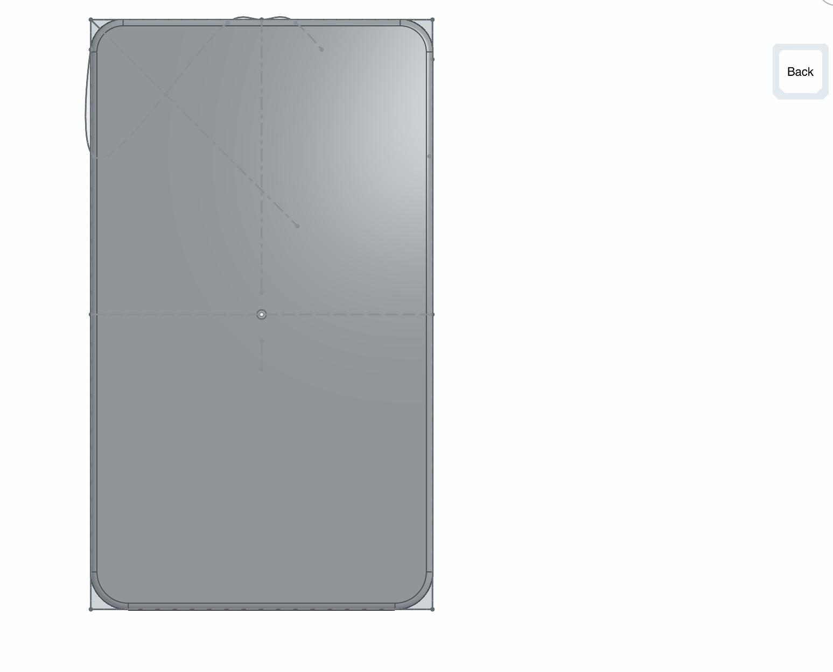
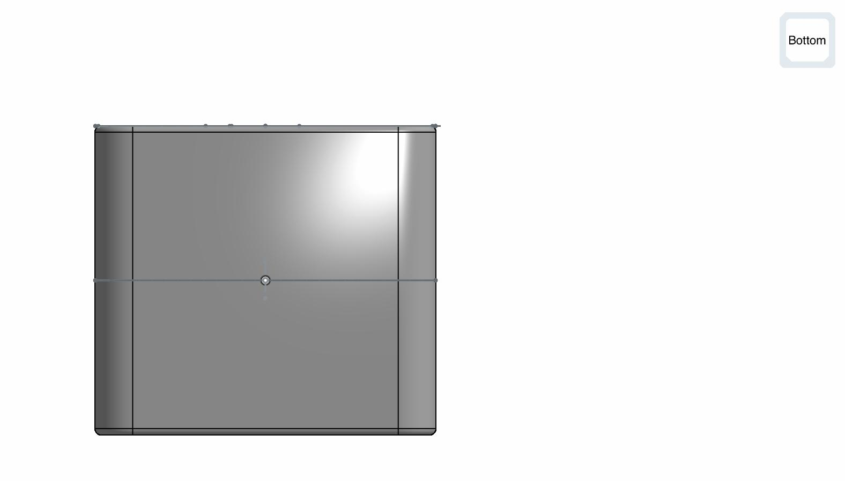
Multiple screenshots of final 3D model(taken from OnShape on iPad app)
Right View
Back View
Isometric
Left View
Bottom View

Slide 5
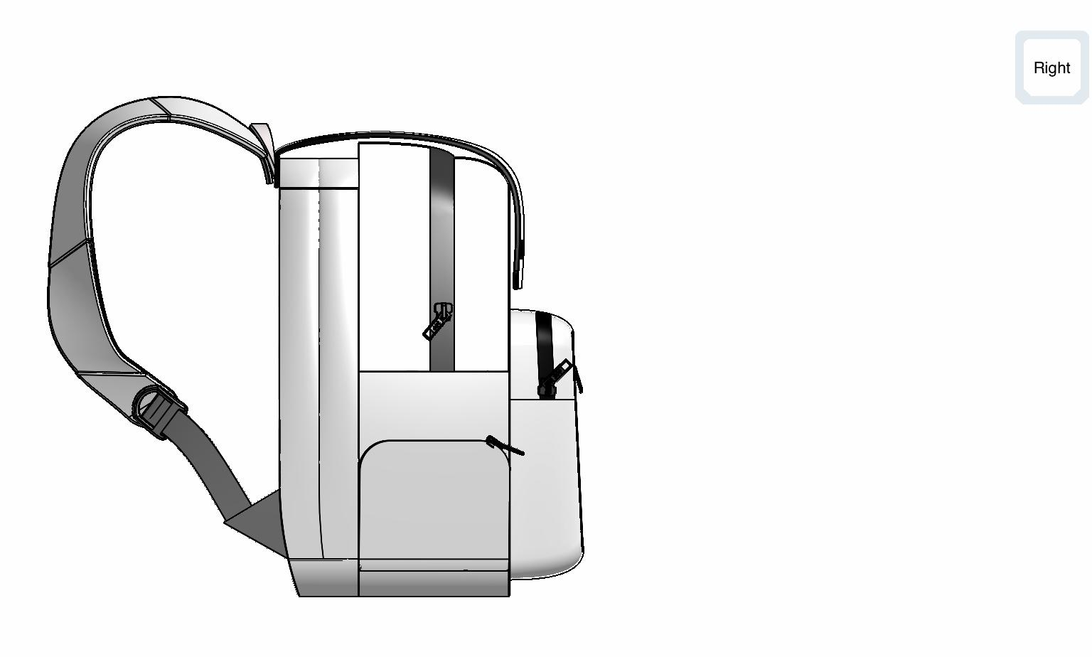
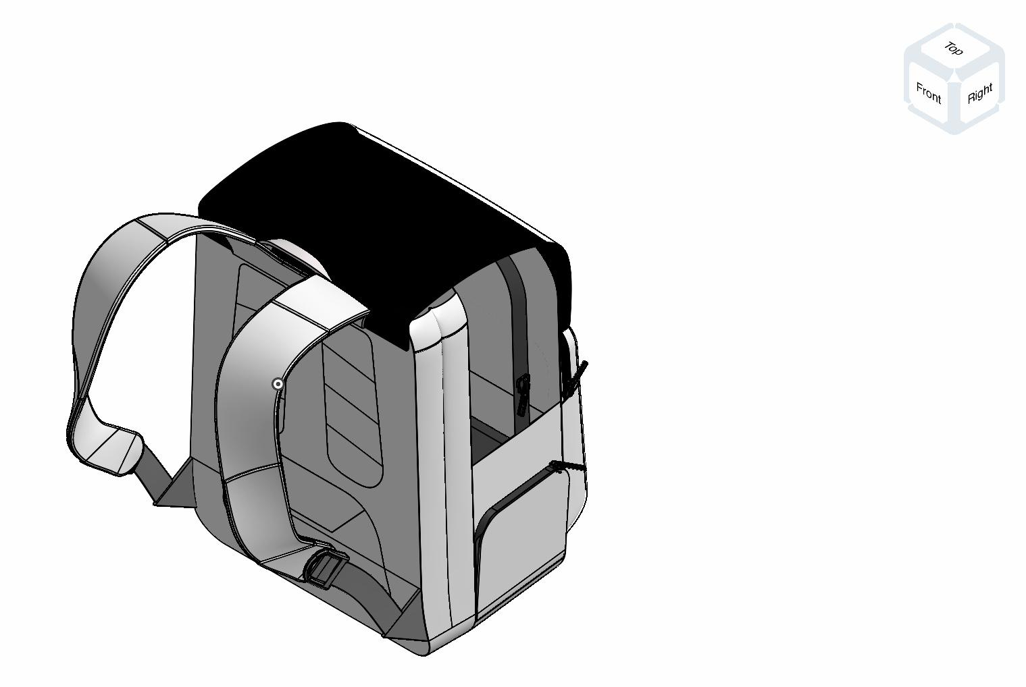
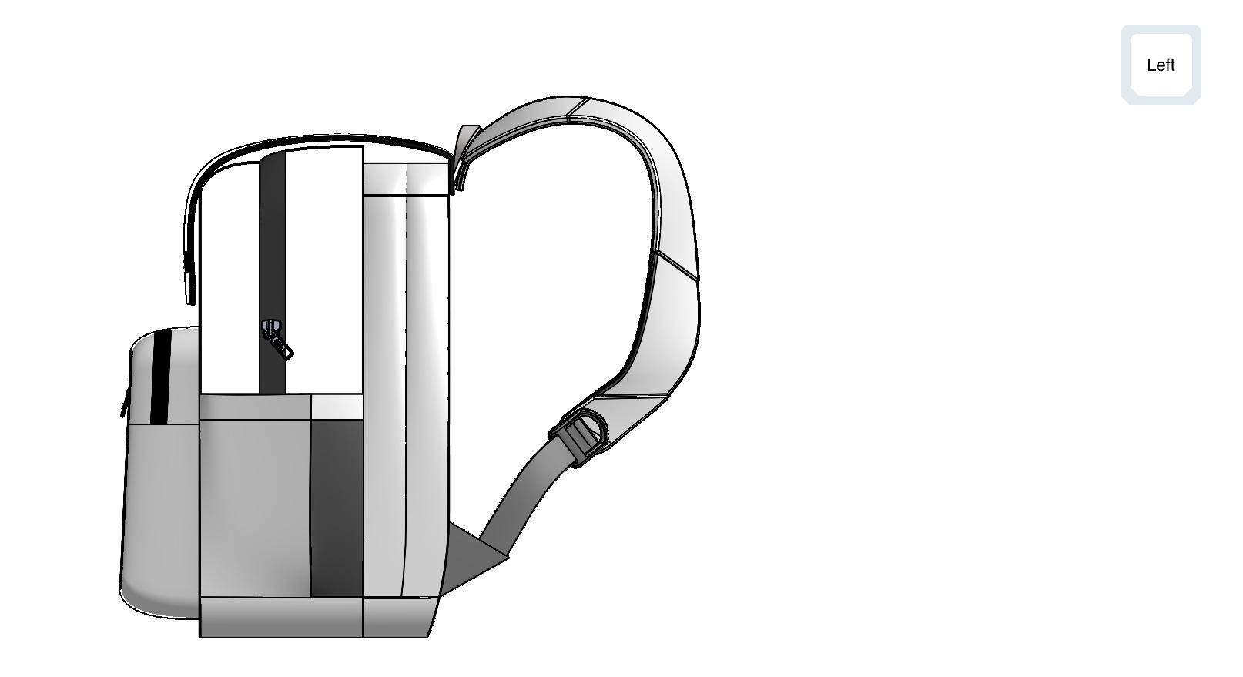
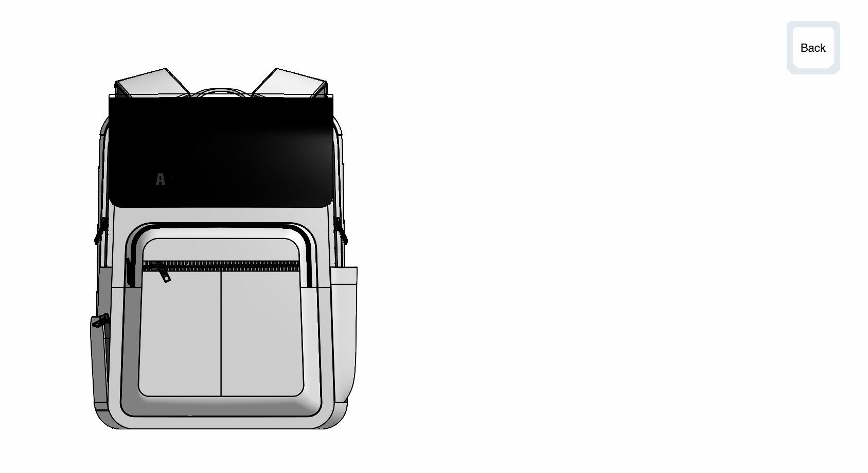
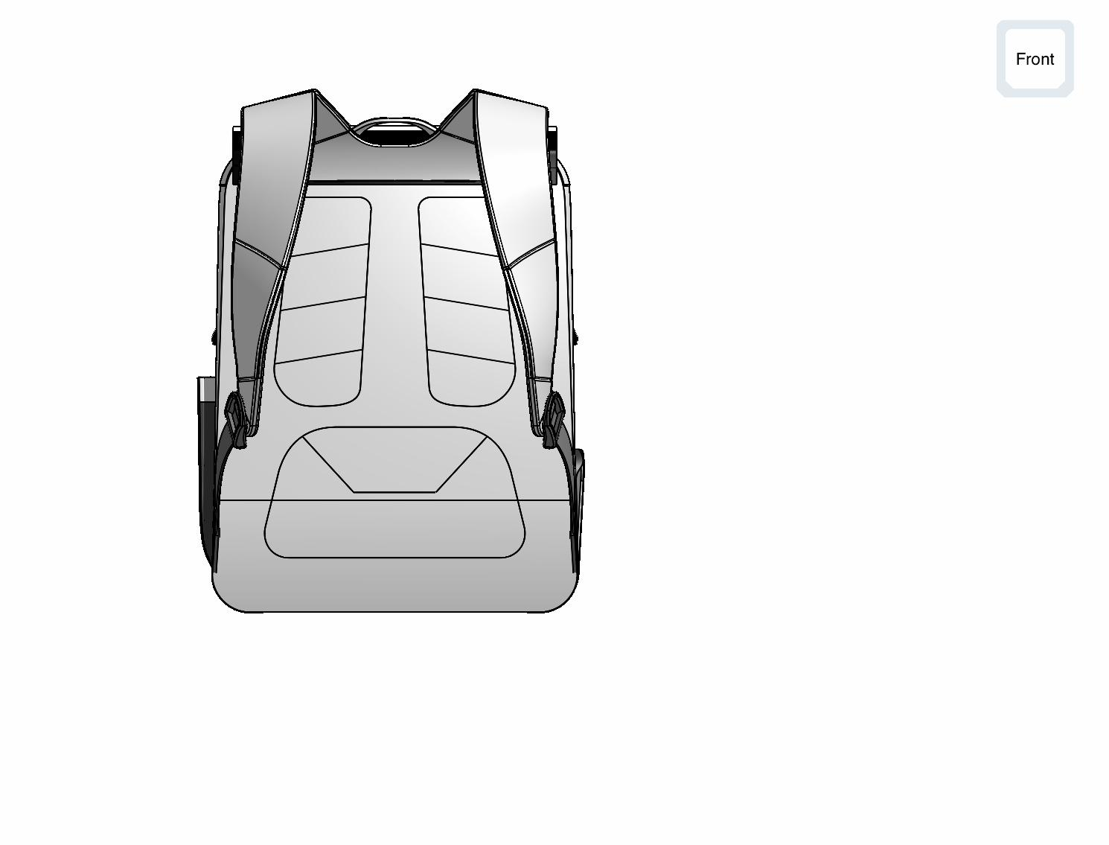
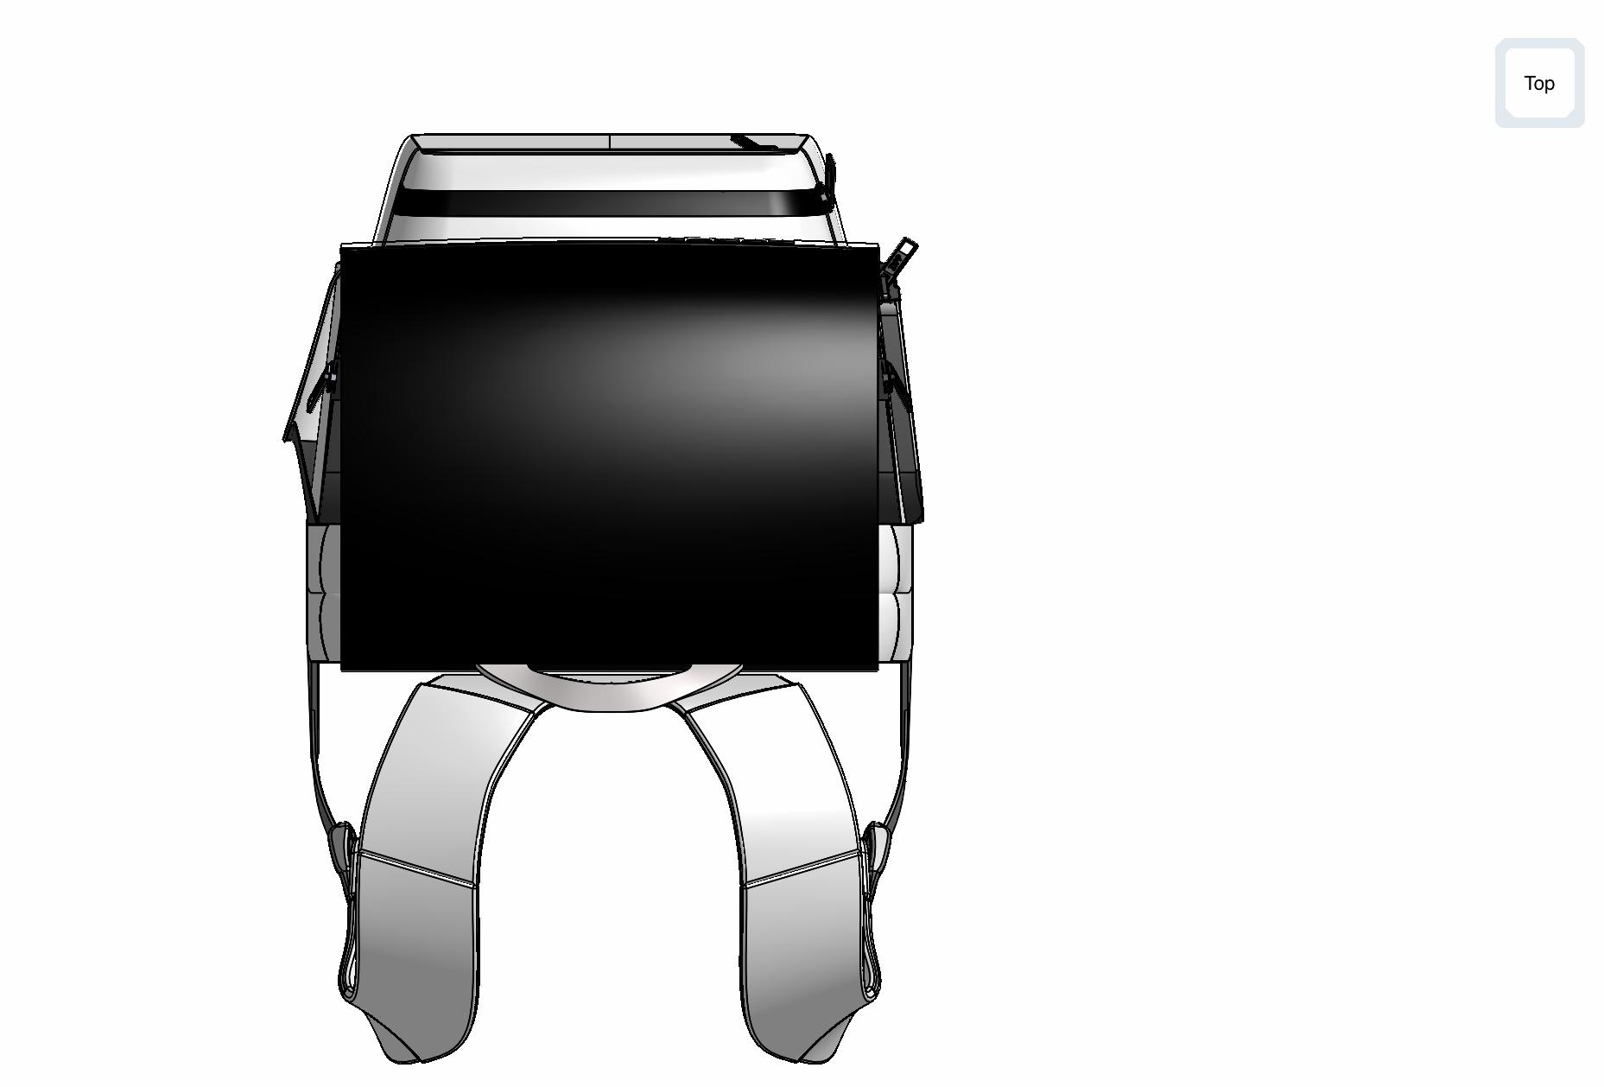
I tried doing the actual complete CAD with the straps and handles but it did not work out the way I hoped it would, but here are the pics...
Right View
Isometric View
Left View
Front View
Back View
Top View

Slide 6
Luggage (backpack) features
Lightweight
Affordable
Durable
Reliable
Waterproof
Mobile
GPS SENSOR(INCLUDED IN CASE CUSTOMER CHANGES, AND HAS TO BUY A NEW BAG)
Handle
2 bottle holders

Slide 7
Cost estimate(Changed from plan)
Even though my prototype is expensive I am planning to give a 50% discount because of the holidays and also I think if it’s cheaper then more people will buy it and I will hopefully get a profit, but I will have to get approval of this discount from my manager and finance department before giving you an actual cost, I will keep you updated.
Total sample cost after 50% discount applied: $102.13 (approx.)
Amount saved: $102.13(approx.)
Services cost example:
2.75 hrs of pattern work @ 22/hr - approx. $60.50
1.25 hrs of cutting @ $25/hr - approx. $31.25
2.50 hrs of sewing @ $25/hr - approx. $62.50
1 hr of finish @ $15/hr - approx. $15.00
Total labor approx. $169.25
Materials approx. $35.00
TOTAL COST ESTIMATE - $204.25 APPROX.
ACTUAL PRICE - APPROX. $359.50

